Slide 1


Guatemala SQL Server user group
April 2019

Slide 2

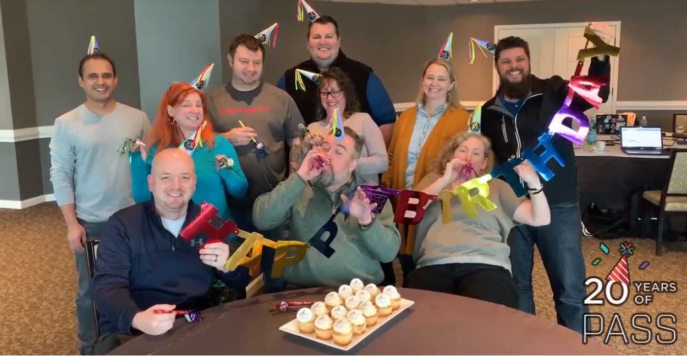
#PASSturns20
Thank you for celebrating with us!
We are so grateful for all the community participation during our #PASSTurns20 activities. Congratulations to all the contest winners who won swag bags of PASS-themed items!
The celebrations aren’t over yet - check out the #PASSturns20 video to see all of the community submitted Happy Birthday messages!

Slide 3

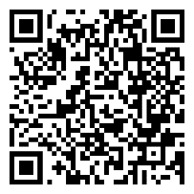
PASS Summit 2019 Pre-Conference Sessions Released!
Join our top-rated, expert pre-conference speakers as they deliver innovative content to propel your learning and grow your skills.
Advanced Virtual SQL Server Performance with David Klee
AI and Power BI: The Realm of the Impossible with Leila Etaati
Move a Successful Legacy On-Premise OLTP SQL Server Database to Azure with Ike Ellis
The SQL Server 2019 Workshop with Bob Ward
And more!
Stay tuned for full details on Tuesday, April 16, 2019!
pass.org/summit/2019/Learn/Pre-ConferenceSessions.aspx

Slide 4



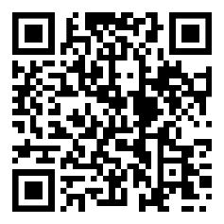
It’s SQL Server Migration Season
End of support for SQL Server 2008 is fast approaching so it’s time to take flight and build your migration plan.
To guide you through this journey, PASS, Microsoft, and Intel have teamed up for a series of expert-led events, giving you all the tools you need to get to your final destination – a modern data platform.
Get started today by registering for our upcoming PASS Marathon: Modernizing Your Data Platform event on May 9.
Register Now
pass.org/marathon/2019/eosreadiness/About.aspx

Slide 5

Upcoming Virtual Group Webinars
Virtual Group | Meeting Date | Time | Topic | Website
DevOps | Apr 23, 2019 | 19:00 – 21:00 (UTC) | How to Overcome the Top Blockers for Implementing Database DevOps - Kendra Little | infrastructurevc.pass.org
Database Administration | Apr 24, 2019 | 16:00 – 17:00 (UTC) | Azure SQL Database-How to keep your business running when disaster strikes? - Taiob Ali | dba.pass.org
Professional Development | Apr 24, 2019 | 17:00 – 18:00 (UTC) | Building Trust In Teams - Richard Campbell | professionaldevelopment. pass.org
Cloud | Apr 25, 2019 | 17:00 – 18:00 (UTC) | Azure Data Factory V2 - Kevin Wilkie | cloud.pass.org

Slide 6
Upcoming Virtual Group Webinars
Virtual Group | Meeting Date | Time | Topic | Website
Business Intelligence | Apr 30, 2019 | 16:00 – 17:00 (UTC) | Power BI Dataflows 201 – Beyond The Basics - Matthew Roche | bi.pass.org
Cloud | May 2, 2019 | 17:00 – 18:00 (UTC) | Benchmarking in the Cloud - Gianluca Sartori | cloud.pass.org
DBA Fundamentals | May 7, 2019 | 16:00 – 17:00 (UTC) | Hardware 201: Selecting and Sizing Database Hardware for OLTP Performance - Glenn Berry | fundamentals.pass.org
Cloud | May 7, 2019 | 17:00 – 18:00 (UTC) | Text Mining & Sentiment Analysis Made Easy - Sanil Mhatre | cloud.pass.org

Slide 7
Upcoming Virtual Group Webinars
Virtual Group | Meeting Date | Time | Topic | Website
Data Architecture | May 8, 2019 | 18:00 – 19:00 (UTC) | Building Your Data Lake on ADLS - Mark Van de Wiel | dataarch.pass.org
Cloud | May 9, 2019 | 17:00 – 18:00 (UTC) | Querying Semistructured Data in Azure Data Lake with USQL - Russel Loski | cloud.pass.org
DBA Fundamentals | May 14, 2019 | 02:30 – 03:30 (UTC) | Using Open Source Products for Collecting Performance Metrics - Tracy Boggiano | fundamentals.pass.org
Cloud | May 14, 2019 | 17:00 – 18:00 (UTC) | Big Data with Azure: where to begin? Concepts and Best Practices - Satya Jayanty | cloud.pass.org

Slide 8
Upcoming Virtual Group Webinars
Virtual Group | Meeting Date | Time | Topic | Website
Cloud | May 16, 2019 | 17:00 – 18:00 (UTC) | IaaS or PaaS? Managed Instance, Azure DB or Azure VM? Why, when, what? - Michelle Gutzait | cloud.pass.org
DBA Fundamentals | May 21, 2019 | 16:00 – 17:00 (UTC) | DevOps Fundamentals: What, who, why and how? - Kendra Little | fundamentals.pass.org
Cloud | May 21, 2019 | 21:00 – 22:00 (UTC) | Modern Azure Data Warehouse - David Alzamendi | cloud.pass.org
Professional Development | May 22, 2019 | 16:00 – 17:00 (UTC) | Taking back control of your work using Kanban - Michael Johnson | professionaldevelopment. pass.org

Slide 9
Upcoming Virtual Group Webinars
Virtual Group | Meeting Date | Time | Topic | Website
Global Italian | May 22, 2019 | 17:00 – 18:00 (UTC) | Mappe personalizzate in Power BI - Andrea Martorana Tusa | globalitalian.pass.org
DevOps | May 22, 2019 | 19:00 – 21:00 (UTC) | How to Introduce your Data Scientists to CI/CD - Alicia Moniz | infrastructurevc.pass.org
Cloud | May 23, 2019 | 17:00 – 18:00 (UTC) | Lambda architecture design using Azure Databricks for Advanced Analytics - Lucas Feiock | cloud.pass.org
Cloud | May 30, 2019 | 17:00 – 18:00 (UTC) | High Availability and Azure - Scaling SQL Server to the Cloud - Matt Gordon | cloud.pass.org

Slide 10






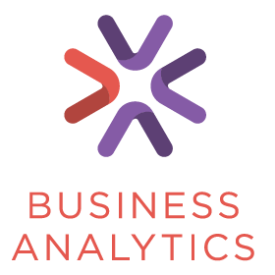






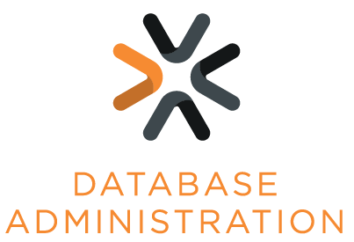




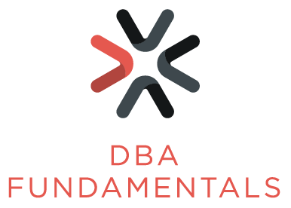



PASS Virtual Groups

Slide 11


Upcoming SQLSaturdays
US/Canada
EMEA
#863 Raleigh – April 27, 2019
#840 Edmonton – April 27, 2019
#807 Redmond – April 27, 2019
#869 Phoenix – May 04, 2019
#835 Philadelphia – May 04, 2019
#820 Jacksonville – May 04, 2019
#845 Atlanta – May 18, 2019
#850 Budapest – Apr 20, 2019
#848 Yaounde – April 27, 2019
#851 Stockholm – May 04, 2019
#852 Finland – May 11, 2019
#871 Sardegna – May 18, 2019
#857 Kyiv – May 18, 2019
#856 Rheinland – May 25, 2019
LATAM
#844 Belo Horizonte – May 18, 2019
#876 Santo Domingo – May 25, 2019

Slide 12
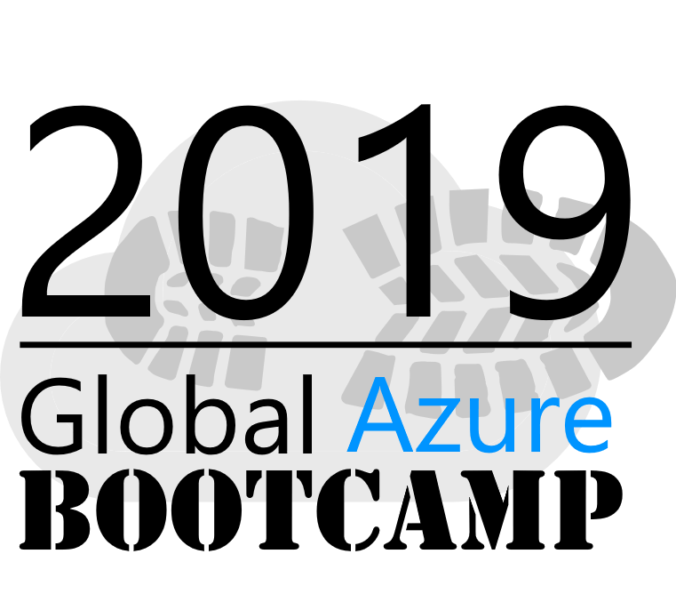


Global Azure Bootcamp 2019
All around the world user groups and communities want to learn
about Azure and Cloud Computing!
On April 27, 2019, all communities will come together once again in the sixth great Global Azure Bootcamp event! Each user group will organize their own one day deep dive class on Azure the way they see fit and how it works for their members. The result is that thousands of people get to learn about Azure and join together online under the social hashtag #GlobalAzure!
Oscar García - Microsoft Regional Director www.linkedin.com/in/oscargarciacolon
Guillermo Zepeda - Microsoft MVP www.linkedin.com/in/guillermozepedaselman
Stanly Bolaños, MCSP www.linkedin.com/in/stanlybolanos
Register here!

Slide 13


Slide 14


Tech news
Azure Data Studio
Azure Data Studio is complementary to SQL Server Management Studio with experiences around query editing and data development, while SQL Server Management Studio still offers the broadest range of administrative functions, and remains the flagship tool for platform management tasks.
Notebook improvements in Azure Data Studio
Notebooks in Azure Data Studio continues to grow in popularity with the release of SQL Notebooks for both SQL Server and PostgreSQL. Improving the Notebook experience for not only the SQL kernel, but for other kernels like Python..
Download link
More information

Slide 15
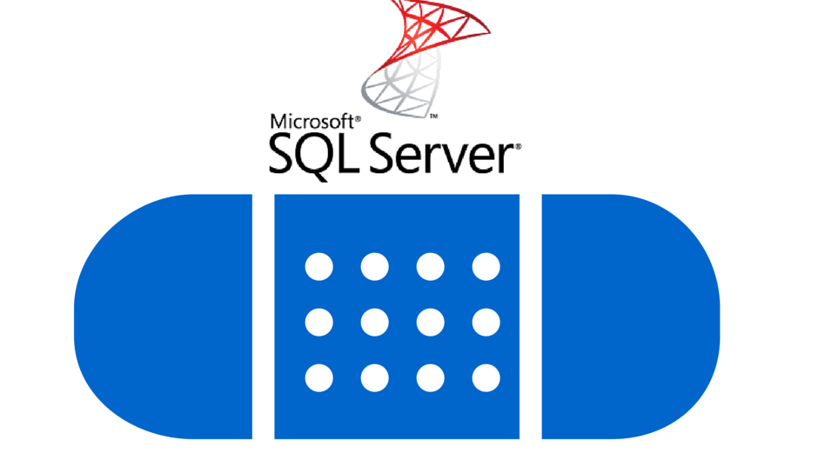

Tech news
Latest patches released by Microsoft
SQL Server 2014 Service Pack 2 Cumulative Update #17 – KB4491540
SQL Server 2014 Service Pack 3 Cumulative Update #3 – KB4491539
Hotfix Release: JDBC Driver 7.2.2 for SQL Server – #1028
SQL Server Management Studio 18
Custom folder
Allows multiple languages
OLEDB driver included
Support for SQL Server 2019
Better Azure SQL Database Support
SSMS \ ADS integration
Release notes

Slide 16
Call for speakers
Want to participate as speaker in the next Guatemala's SQL Server User Group meeting? Just fill out the online form with a brief description of your session here:
https://gtssug.pass.org/en-us/sessionsubmission.aspx

Slide 17


Thanks to our sponsors!
Want to become a sponsor? Send an email to: gtssug@pass.org

Slide 18





Follow us
Sign up for a free membership today at:
GTSSUG.PASS.org
#SQLPassGT @gtssug

Slide 19


Connect with PASS
Sign up for a free membership today at:
PASS.org
#sqlpass @sqlpass
@passcommunity

